Slide 1
Cultural transmission
http://compcogscisydney.org/psyc3211/
A/Prof Danielle Navarro
d.navarro@unsw.edu.au
compcogscisydney.org

Slide 2
Where are we?
L1: Connectionism
L2: Statistical learning
L3: Semantic networks
L4: Wisdom of crowds
L5: Cultural transmission
L6: Summary

Slide 3
Structure of the lecture
Introduction to the topic
Revealing inductive biases?
Example: function learning
Caveat: distortion by individual differences
Cumulative cultural evolution

Slide 4
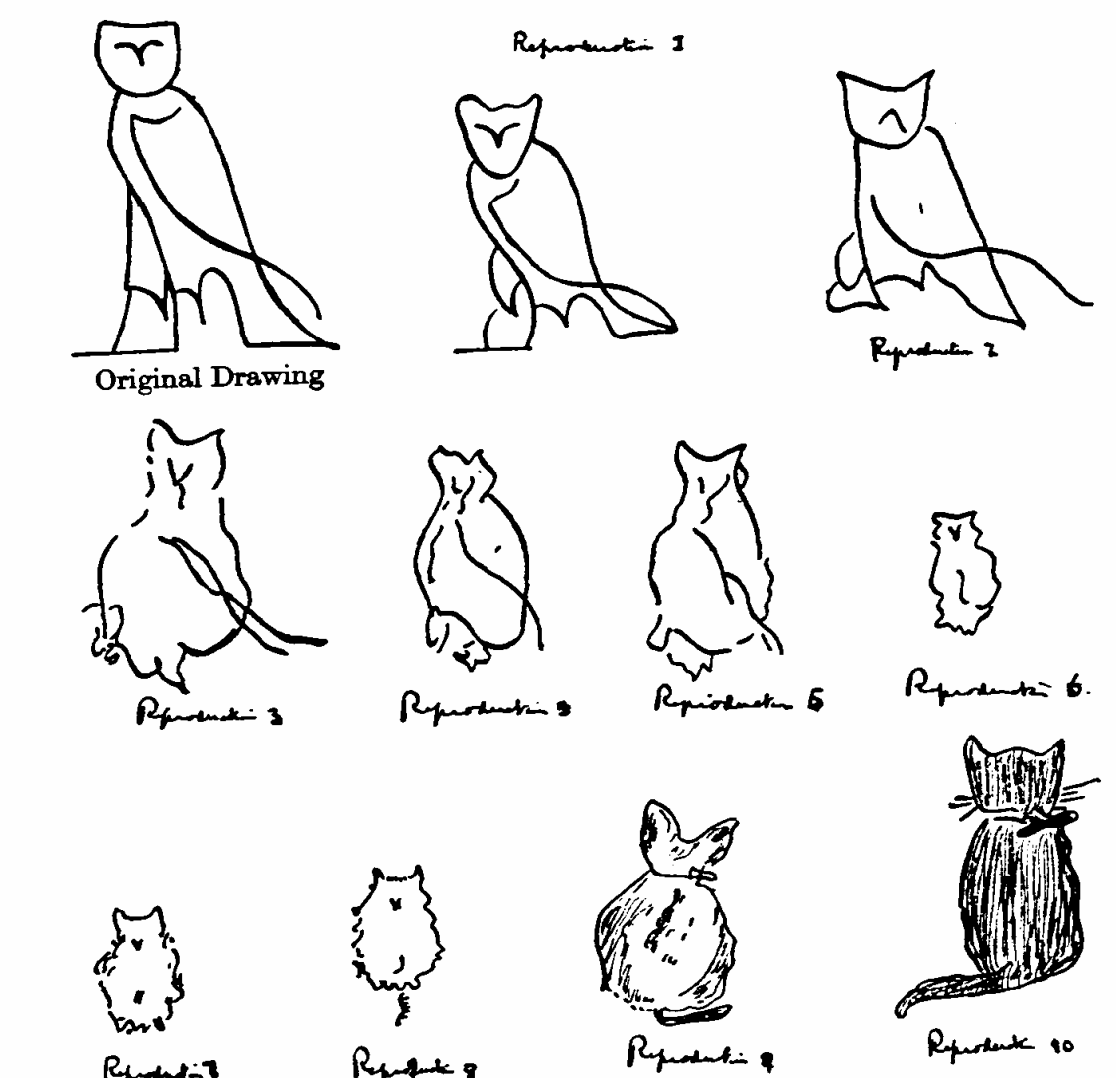
Person #1 draws an owl

Slide 5
Person #2 attempts to copy it

Slide 6
Person #3 makes a copy of the copy

Slide 7
Person #4 makes a copy of the copy of the copy…

Slide 8
Person #5

Slide 9
Person #6

Slide 10
Person #7

Slide 11
Person #8

Slide 12
Person #9

Slide 13
Person #10

Slide 14
Person #22

Slide 15
Owl → Cat

Slide 16
Are these changes random?
Are they meaningful?
What processes are going on here?
The method of serial reproduction
Bartlett (1920)
Cultural transmission by iterated learning
Kalish et al (2007)

Slide 17
Iterated learning reveals inductive biases?
Theoretical claim:

Slide 18
Iterated learning
Sequential experimental design used to study cultural transmission
Each person has to learn something… then produce responses
The responses from one person become the data for the next person

Slide 19
Bayesian iterated learning
(Kalish et al 2007; Griffiths & Kalish 2007)
How do these “chains” of learners behave?
Suppose each person is a Bayesian reasoner
Each person has a prior P(h), then sees data d
Responses generated by sampling from P(h|d)

Slide 20
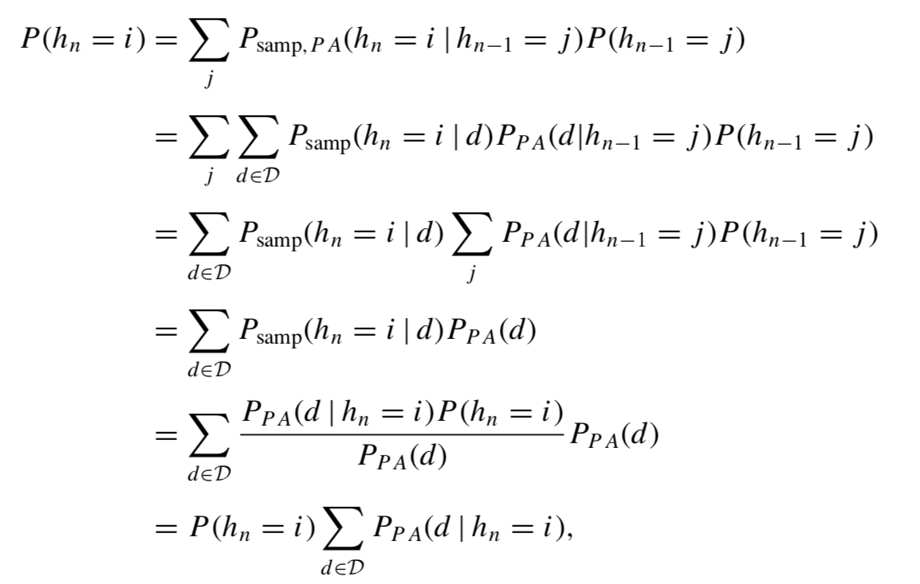
Bayesian iterated learning
(Kalish et al 2007; Griffiths & Kalish 2007)
They did some maths
The formal details don’t matter for this class, but the take home message is that when Bayesian learners all share the same prior P(h), an iterated learning chain eventually starts to reflect the biases in that prior
* There are other conditions too

Slide 21
A function learning task
Empirical test:

Slide 22
Function learning problems
How do people learn to the relationship between different (continuous) quantities?
This function might be tell you the of how many properties you could afford to rent, plotted as a function of your income
Output value
(e.g., properties you can afford)
Input value
(e.g., income)

Slide 23
Function learning problems
There are many possible types of function
Consistent finding in the function learning literature is that people find it easiest to learn positive linear functions
Positive linear
Negative linear
U-shaped
Prediction: iterated learning chains for a function learning experiment should be biased towards positive linear

Slide 24
Function learning task
(Kalish et al 2007)
The blue bar told participants the input value
Participants could adjust the red slider to make their prediction about the output value

Slide 25
Function learning task
(Kalish et al 2007)
Show stimulus and get response
Provide feedback indicating what the correct response should have been
Unbeknownst to participants, this feedback was taken from the responses of the previous participant
Repeat for many trials
Followed by a test phase where no feedback is given
Test phase responses become feedback for next person

Slide 26
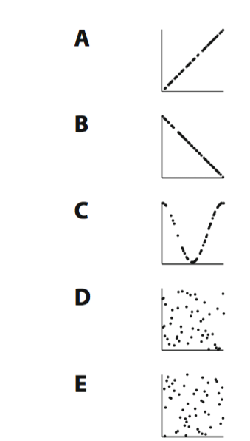
Bayesian iterated learning
(Kalish et al 2007)
Positive linear
Several iterated learning chains were “initialized” with different functions (i.e., used as feedback for the first person)
Negative linear
U-shaped

Slide 27
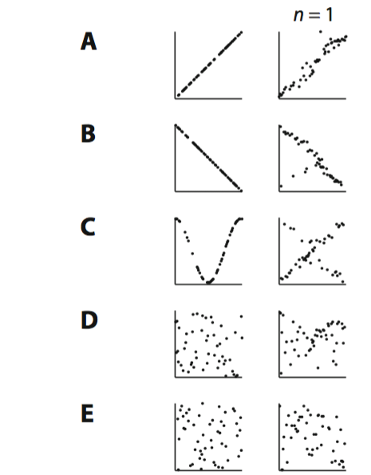
Bayesian iterated learning
(Kalish et al 2007)
Positive linear
Responses from the first person distort the functions in a systematic way…
These now become data for the next person
Negative linear
U-shaped

Slide 28
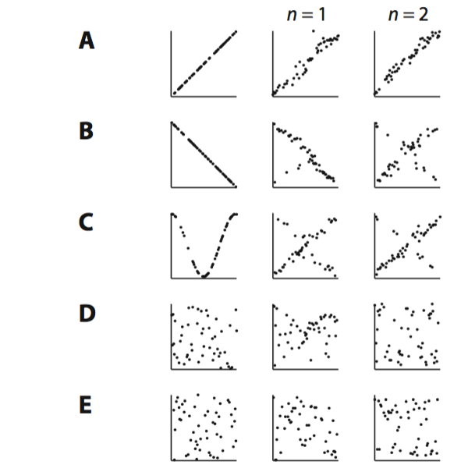
Bayesian iterated learning
(Kalish et al 2007)
Positive linear
The second person’s responses distort the function a bit more…
Negative linear
U-shaped

Slide 29
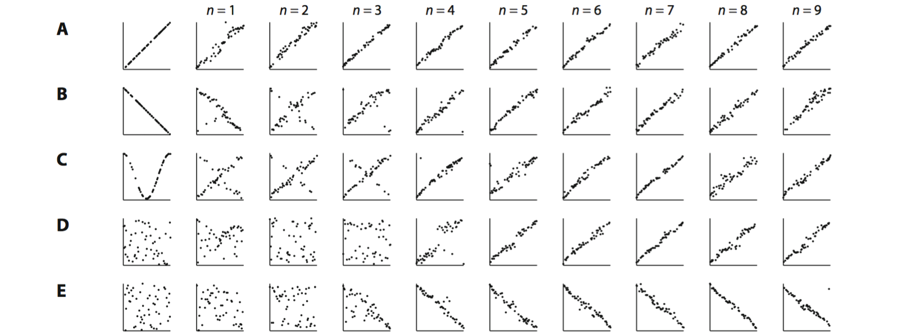
Bayesian iterated learning
(Kalish et al 2007)
… by the ninth person, the biases of the participants have overwhelmed the input

Slide 30
What happens when people have different biases?

Slide 31
Individual differences matter
(Navarro et al 2018)
Some people reproduce faithfully
Others do not

Slide 32
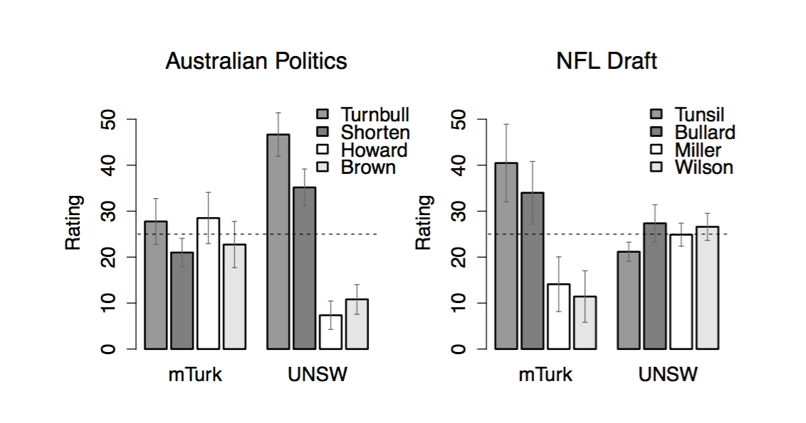
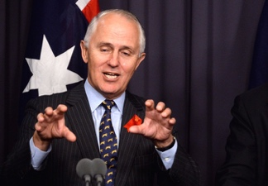
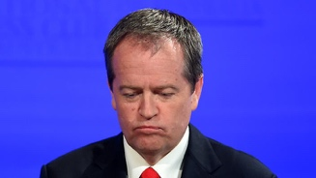
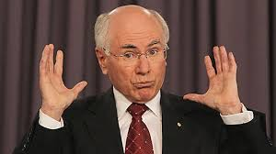
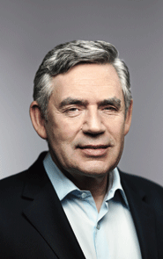
Individual differences matter
(Navarro et al 2018)
Who will win the 2016 election?
Turnbull
Shorten
Howard
Brown
N=80 MTurk workers and UNSW students

Slide 33
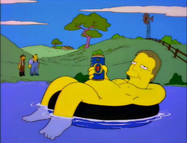
Individual differences matter
(Navarro et al 2018)
US participants have no knowledge of Australian politics
N=80 MTurk workers and UNSW students

Slide 34
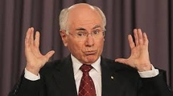
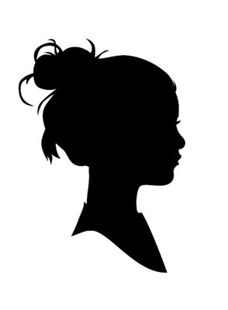
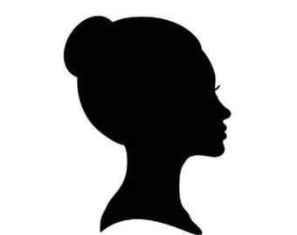
Individual differences matter
(Navarro et al 2018)
The advisor task…
???
???

Slide 35
N=196 MTurk workers
N=124 UNSW students

Slide 36
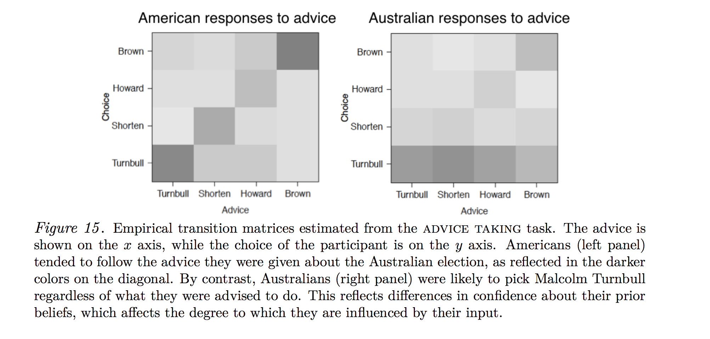

Slide 37
We can “remix” the responses in different proportions to see what happens when we mix learners with different biases together

Slide 38
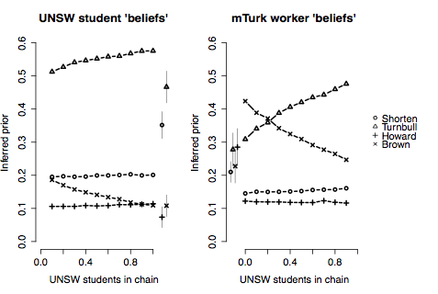
Americans claim to be totally ignorant about Australian politics…

Slide 39
… and an all American iterated learning chain “reveals” a “preference” for Gordon Brown …

Slide 40
If we mix some Australians into the chain the Americans endorse Malcolm Trunbull
Proportion Australian

Slide 41
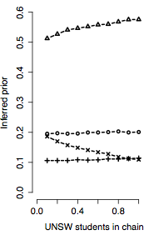
Australians choose Turnbull no matter how many Americans are included
Proportion Australian

Slide 42
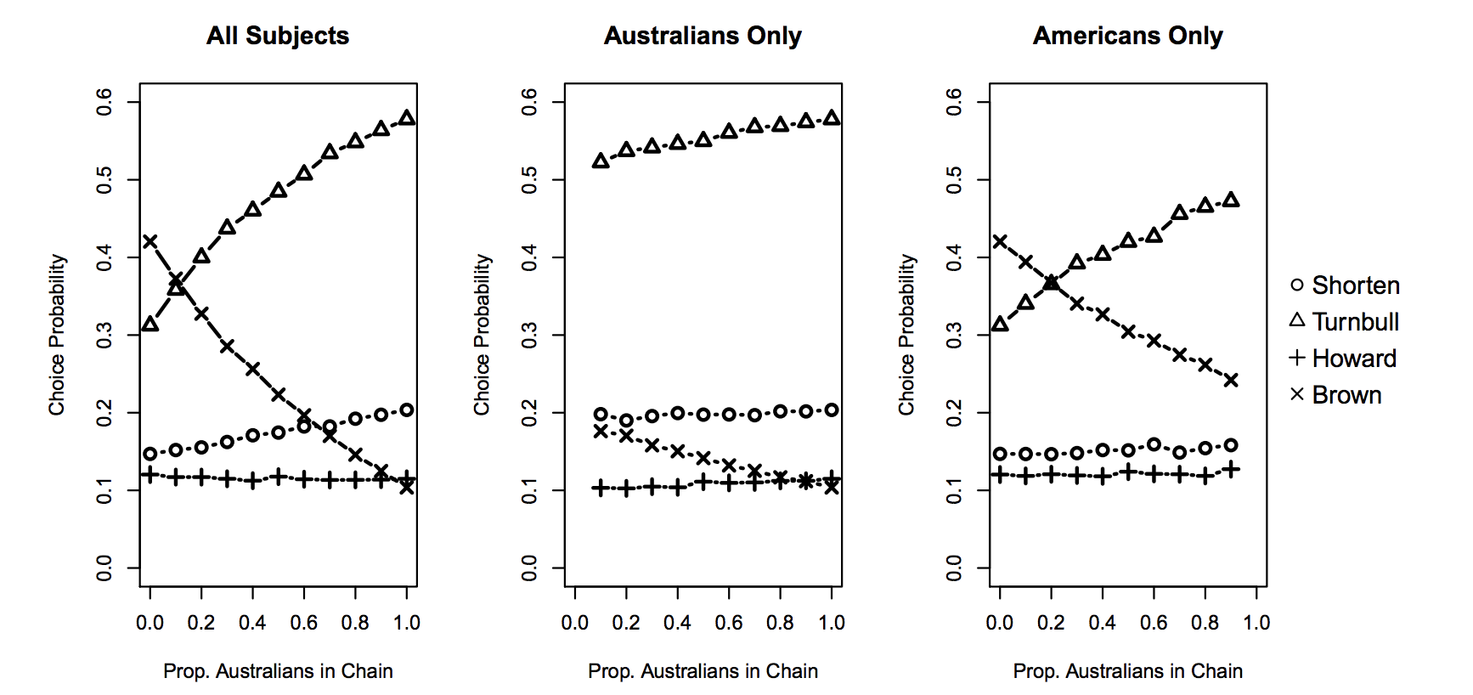
Stronger biases/beliefs win?

Slide 43
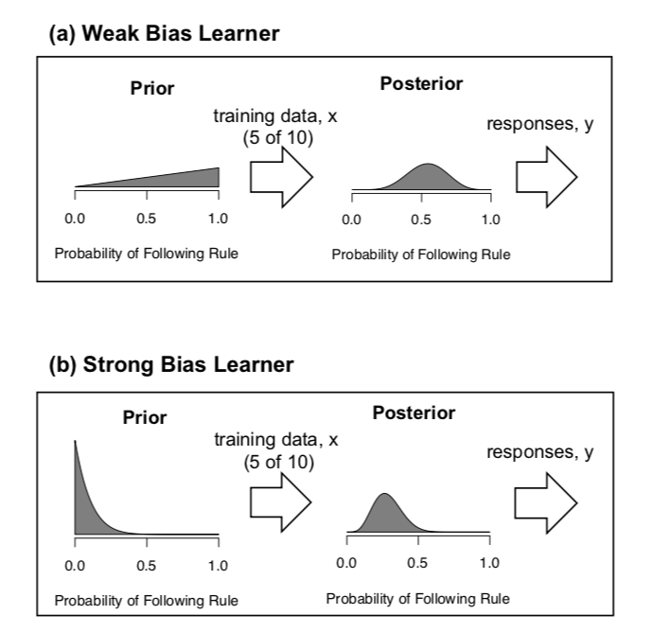
Stronger biases/beliefs win

Slide 44
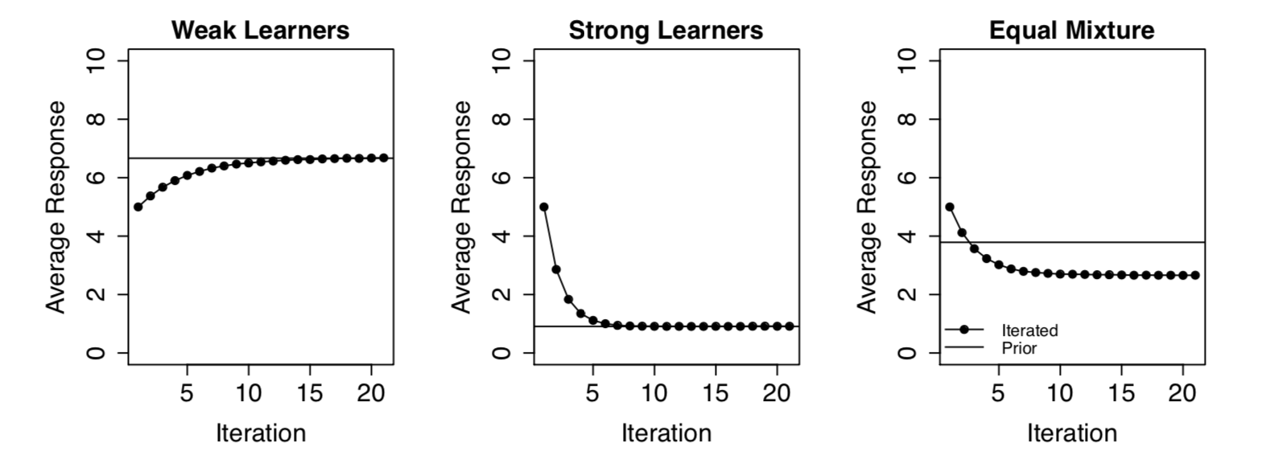
Stronger biases/beliefs win

Slide 45
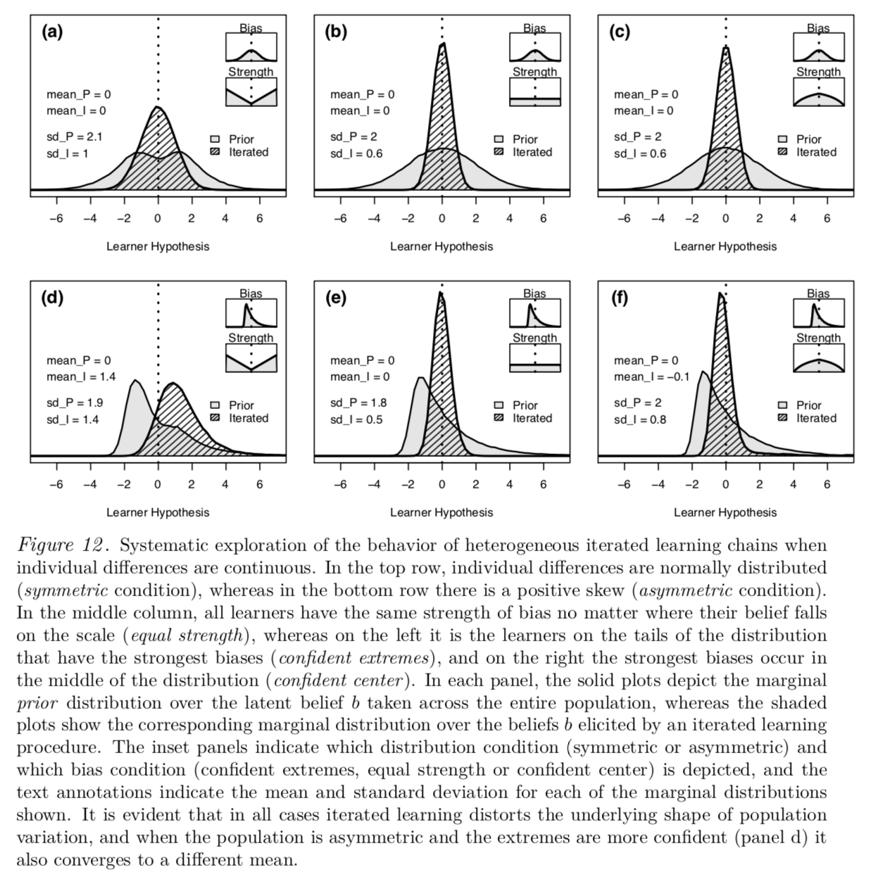
The distortion depends on lots of factors
One consistent pattern… if there are people with extreme beliefs and high confidence on “one side” but no corresponding group on the other side, iterated learning chains will favour those with extreme views
Pretty hard to say how well this generalises to real life though

Slide 46
Cumulative cultural evolution

Slide 47
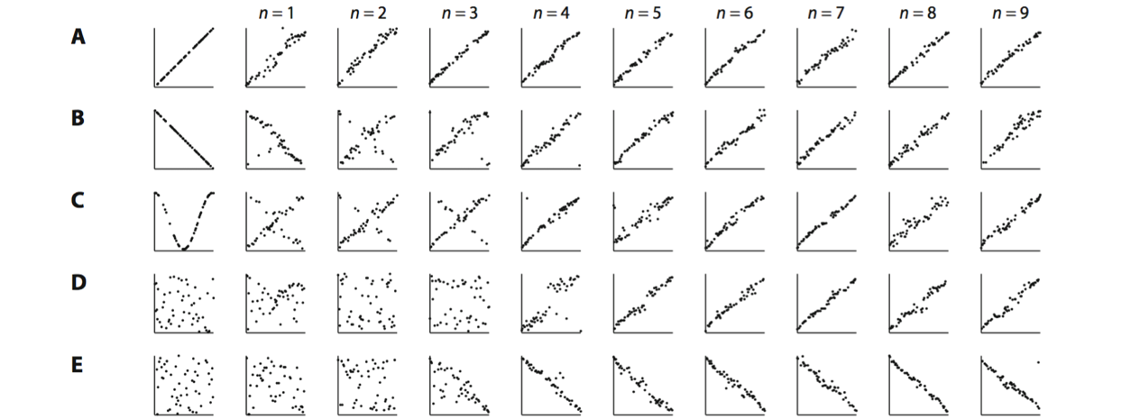
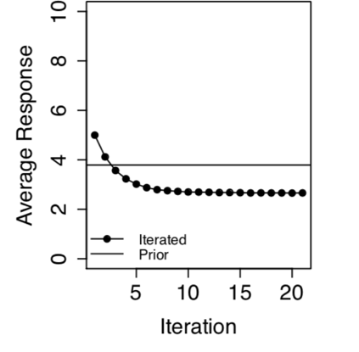
This is kind of depressing???
Does social transmission mean we just live in an echo chamber and all we get out are the biases we put in????
Or worse… one that amplifies the most extreme voices????

Slide 48
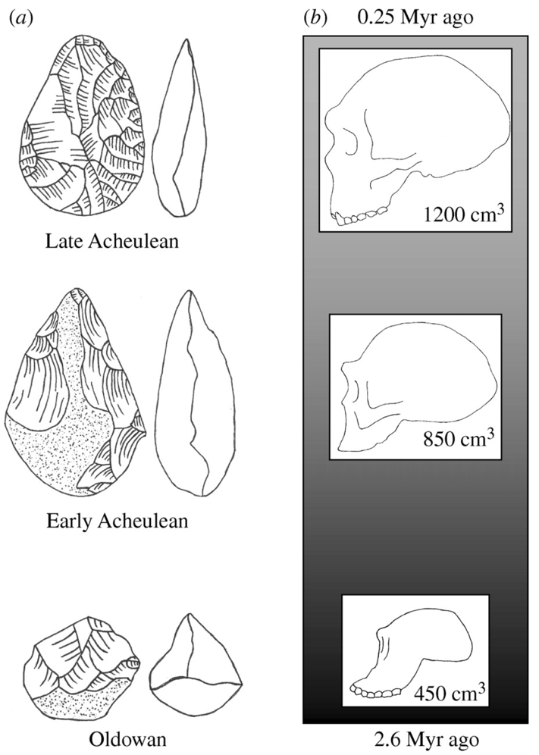
Not necessarily!
Cumulative cultural evolution obviously happens, the only question is how…
Improvements in stone making technology might accompany biological evolution???
But of course that hardly explains lasers…
(Stout et al 2008)

Slide 49
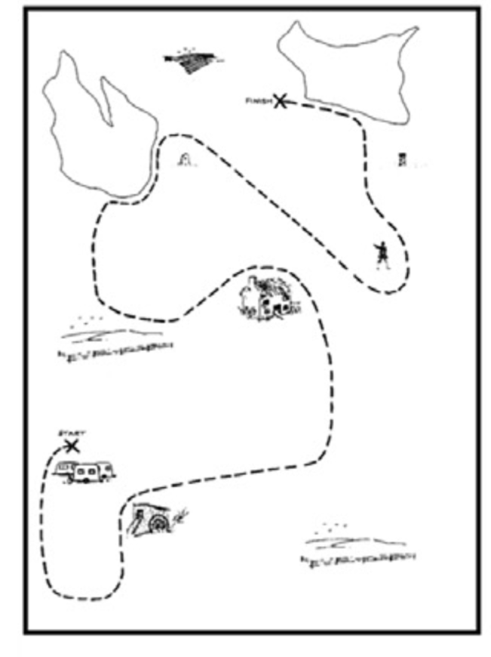
Cumulative cultural evolution for social artefacts
(Fay et al 2018)
The “instruction giver” has a map with a route marked out on it
The “instruction follower” has the same map without the route
The instruction giver has to describe the path to be drawn via text messaging (in 10 mins)
(observation) The follower cannot send messages
(coordination) They can text back and forth
The follower becomes the new instruction giver for the next iteration using a new map and new route

Slide 50
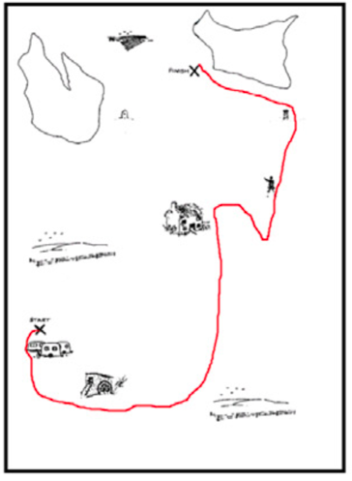
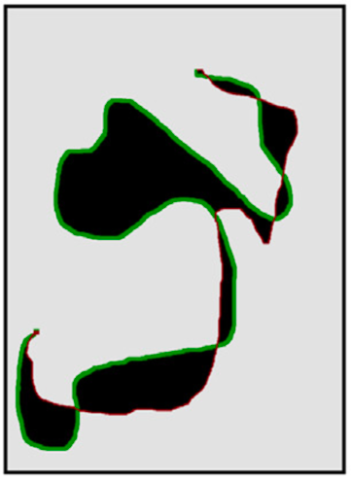
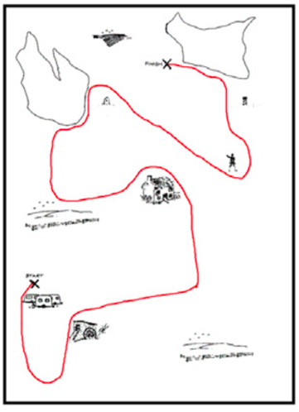
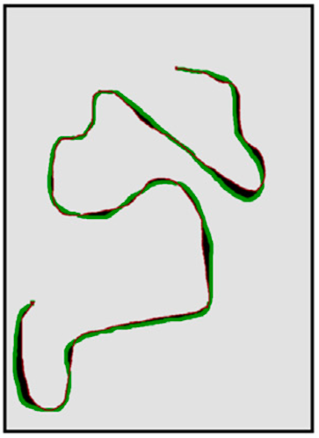
Cumulative cultural evolution for social artefacts
(Fay et al 2018)
Reproduction accuracy is given by the size of the grey area
Low accuracy map means there are bigger deviations (black) between the two curves
High accuracy map means there are very few black pixels and many grey pixels

Slide 51
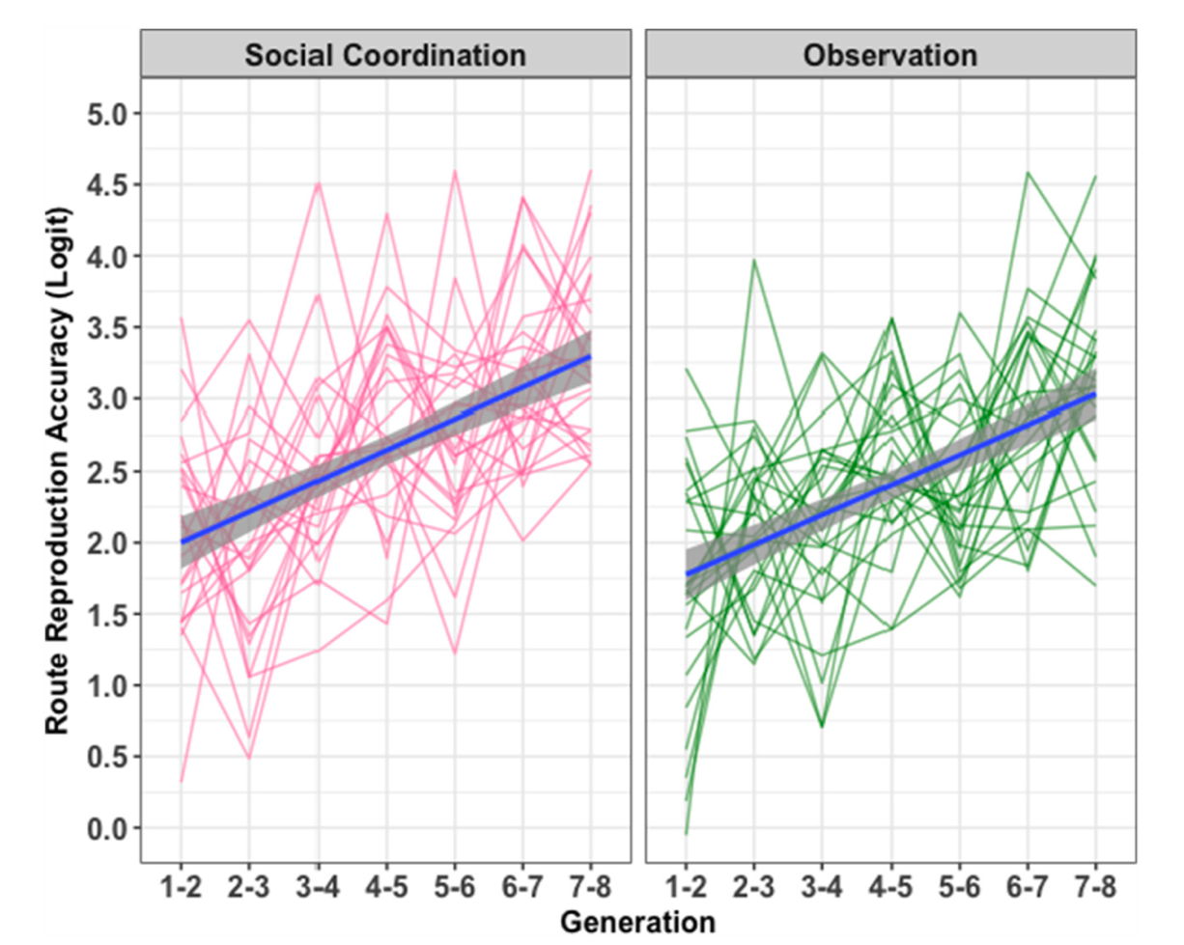
Cumulative cultural evolution for social artefacts
(Fay et al 2018)
408 participants
51 x 8-person chains
25 coordination chains
26 observation chains
Both conditions show improvement across generations
Slightly higher fidelity in the social coordination condition
These two factors account for about 30% of all variability
But how????

Slide 52
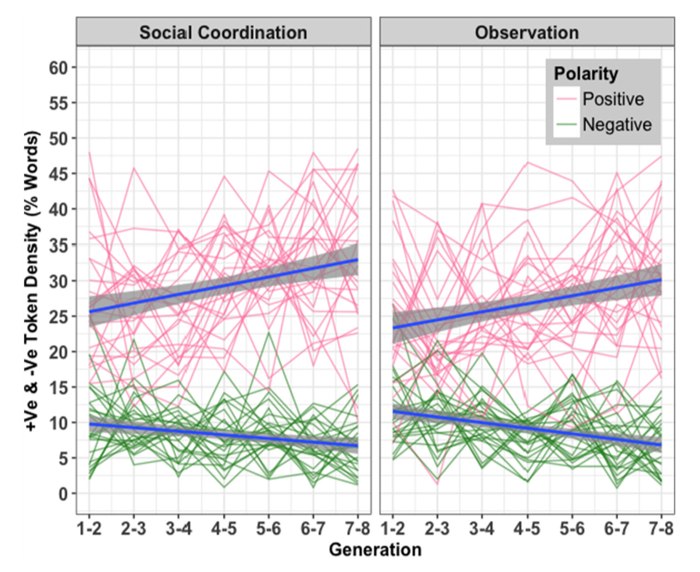
Cumulative cultural evolution for social artefacts
(Fay et al 2018)
Use more good words!
Positive words are those that correlate with better solutions.
The proportion of positive words increased across generations in both conditions
Negative words are those that correlate with bad solutions
The negative words decline across generations but not much

Slide 53
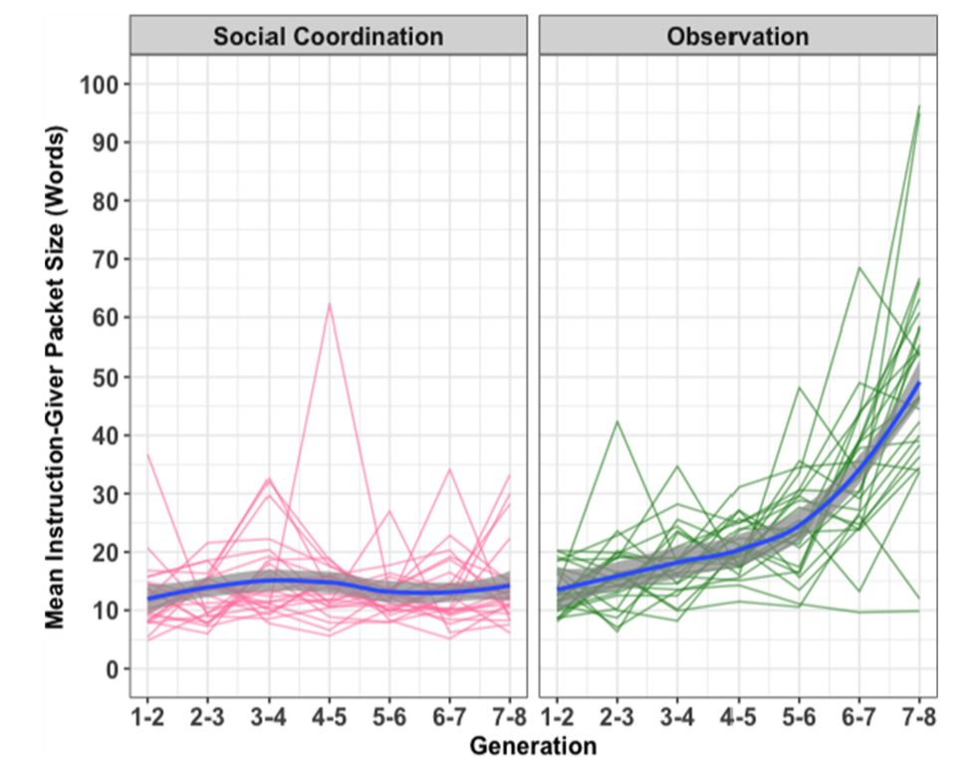
Cumulative cultural evolution for social artefacts
(Fay et al 2018)
Exploratory analyses
Curiously, they found that in the observation condition people learned to give “large packets”
Likely explanation… when there’s no actual social interaction, you learn it’s more effective to draft the whole instruction beforehand?

Slide 54
Thanks

