Slide 1
Semantics and meaning
http://compcogscisydney.org/psyc3211/
A/Prof Danielle Navarro
d.navarro@unsw.edu.au
compcogscisydney.org
*mild content notice for sexual/sexist language

Slide 2
Where are we?
L1: Connectionism
L2: Statistical learning
L3: Semantic networks
L4: Wisdom of crowds
L5: Cultural transmission
L6: Summary

Slide 3
Structure of the lecture
Refresher:
Semantic priming
Semantic networks
The small world of words project
Structure in semantic networks:
Local structure
Remote associations
Large scale structure
Semantic networks of individuals
Semantic networks over development

Slide 4
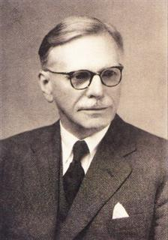
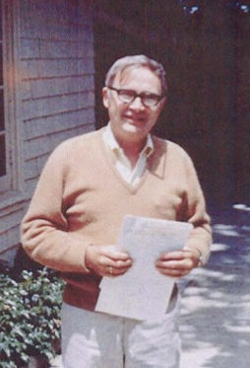
“You shall know a word by the company it keeps”
- John Firth, 1957
“The interest of psychologists in associations has always been misguided because the whole classical analysis of associations centered around the circumscribed and uninteresting problem of stimulus - response, of what follows what.”
- James Deese, 1965

Slide 5
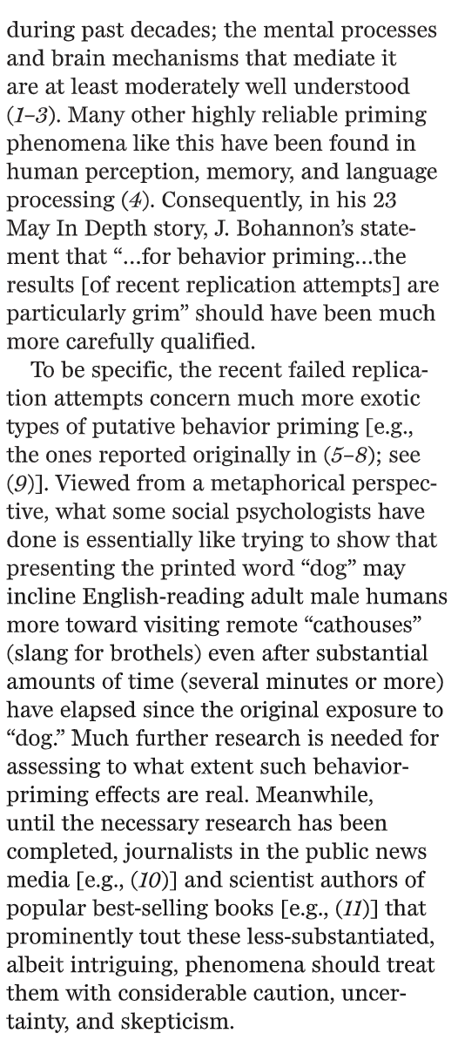
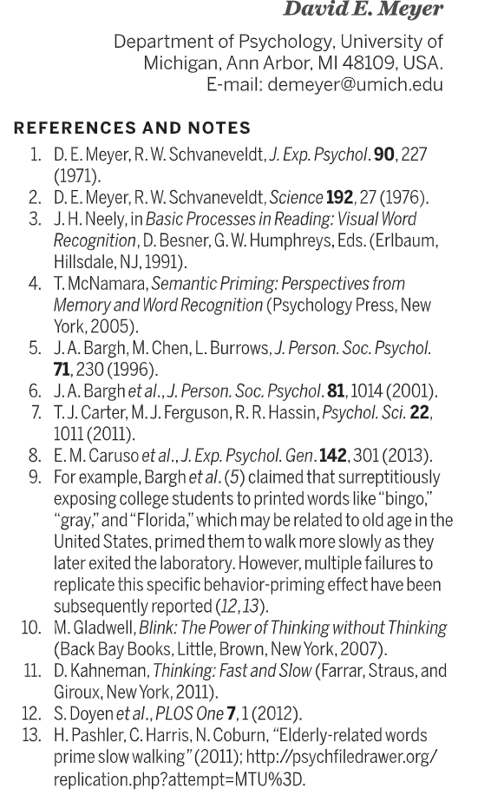
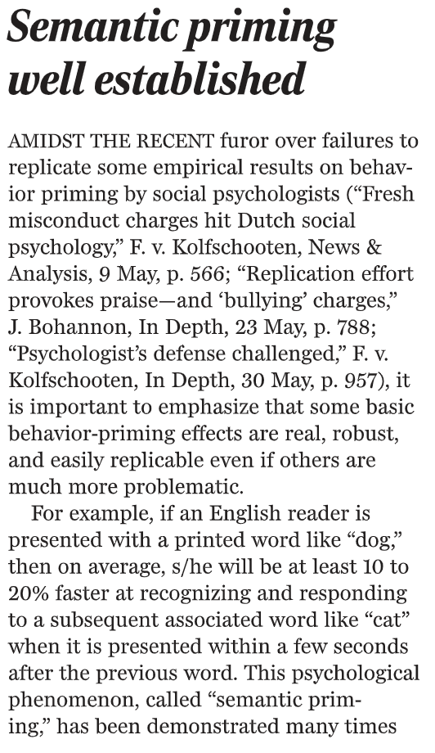
Semantic priming
(Meyer 2014)

Slide 6
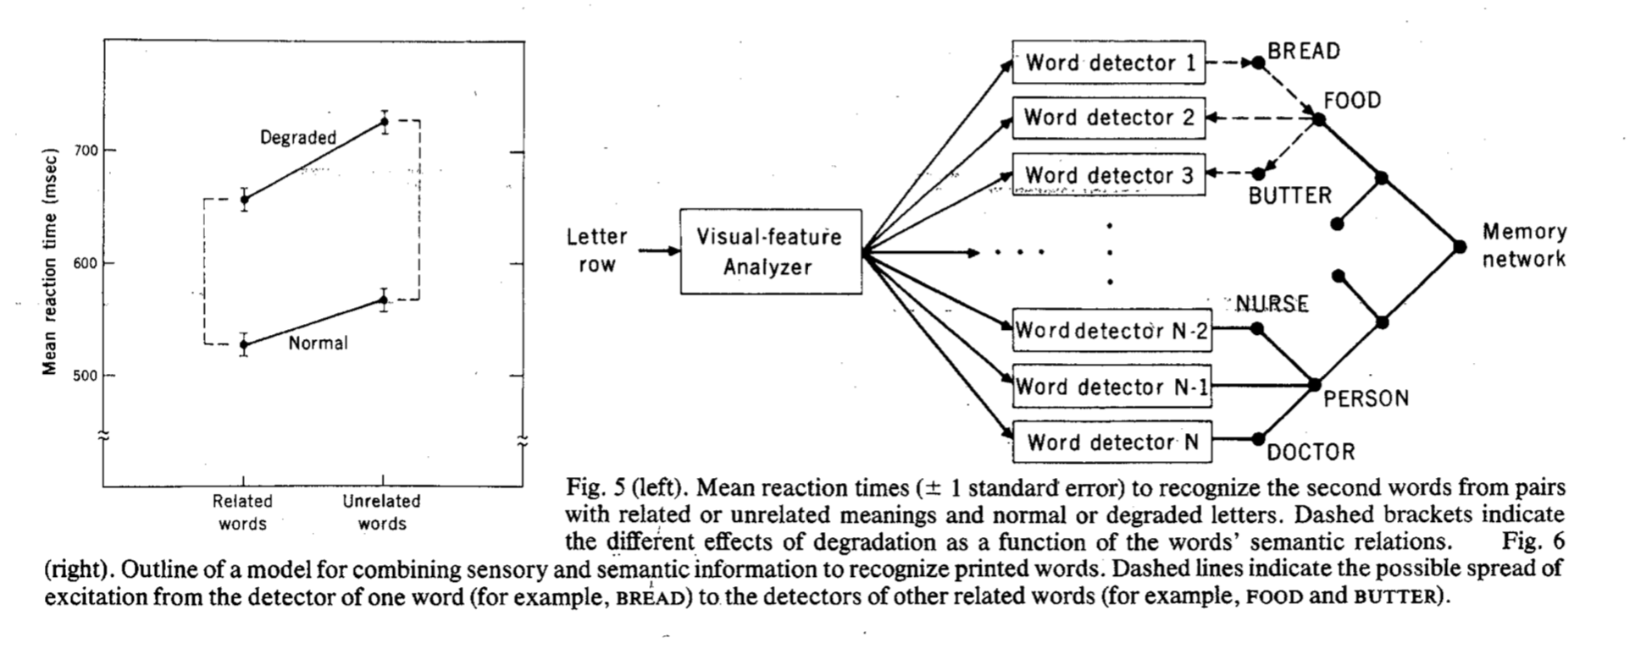
Semantic priming
(Meyer and Schvaneveldt 1976)

Slide 7
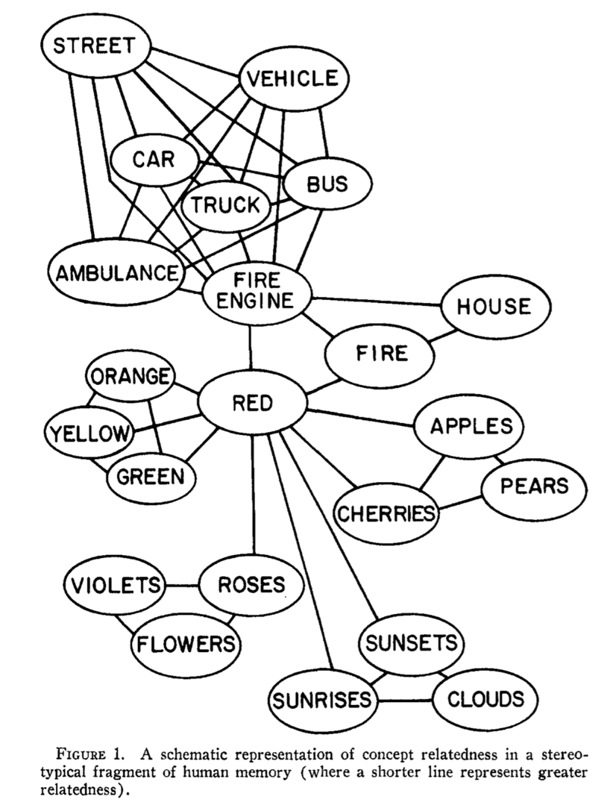
Semantic networks
(Collins & Loftus 1975)
Semantic memory
Concepts organized as nodes in a network
Edges connect related concepts
Edges can describe different relations
Edges can be different lengths
Memory retrieval
Activation spreads along the edges
Activation decays over time

Slide 8
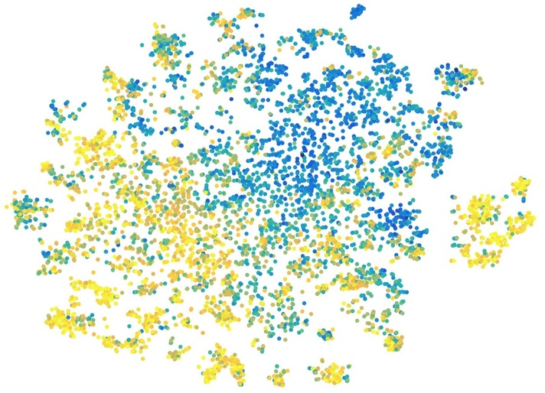
Spreading over what?
This is a simple network with 22 words
This is approximately 12,000 words

Slide 9
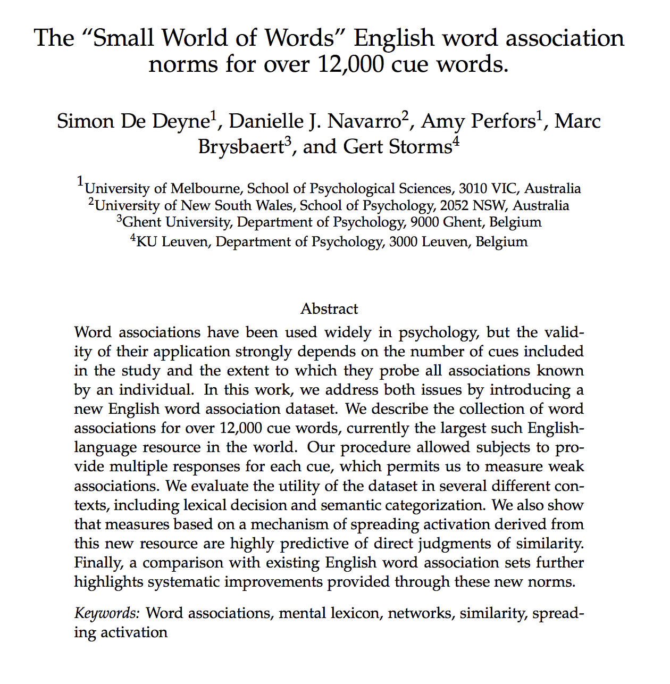
(De Deyne et al, in press)
https://smallworldofwords.org/en/project/home

Slide 10
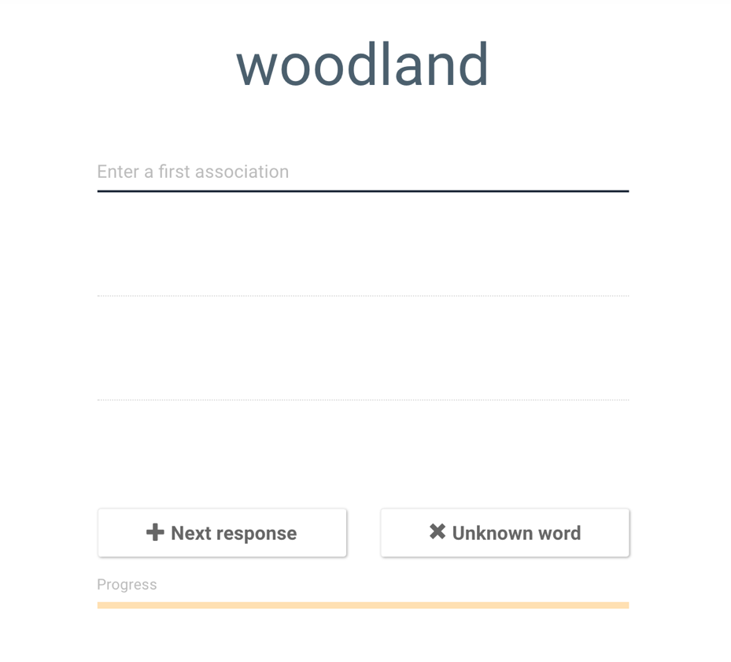
The “small world of words” norms
(De Deyne et al, in press)
Large scale online study
90,701 native English speakers
81% American English speakers
62% identified as female
Average age 36
Educated: 43% with college degree
Participants shown a cue word
Asked to type the first three response words that come to mind
Data for 12,292 cue words
100 participants per cue
About 3.6 million responses

Slide 11
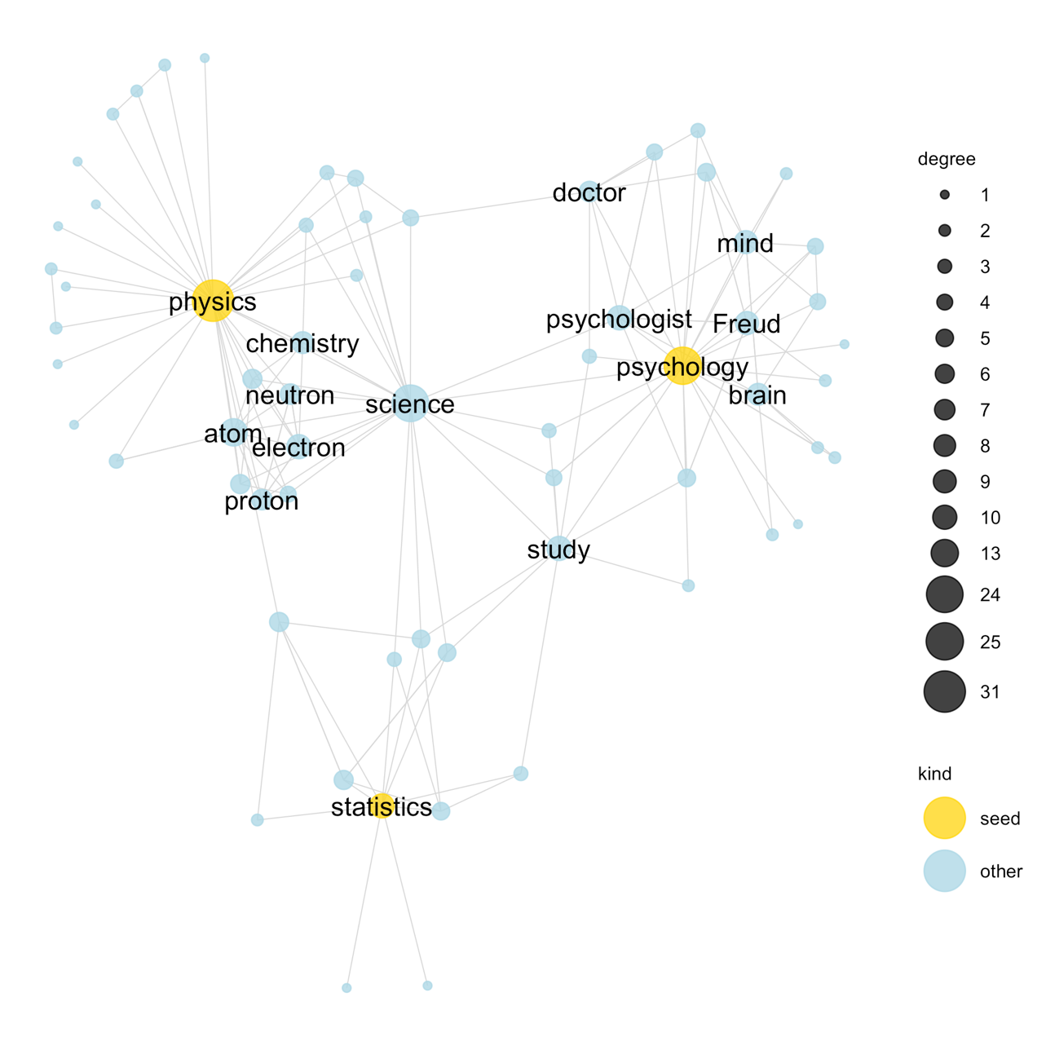
Local structure
Construct a “neighbourhood” network by spreading from cue words
Example 1
Cue: (physics, psychology, statistics)
Science is the concept that links them together
(The layout is a data visualisation that tries to ensure that distances on the screen are similar to the distances in the network)

Slide 12
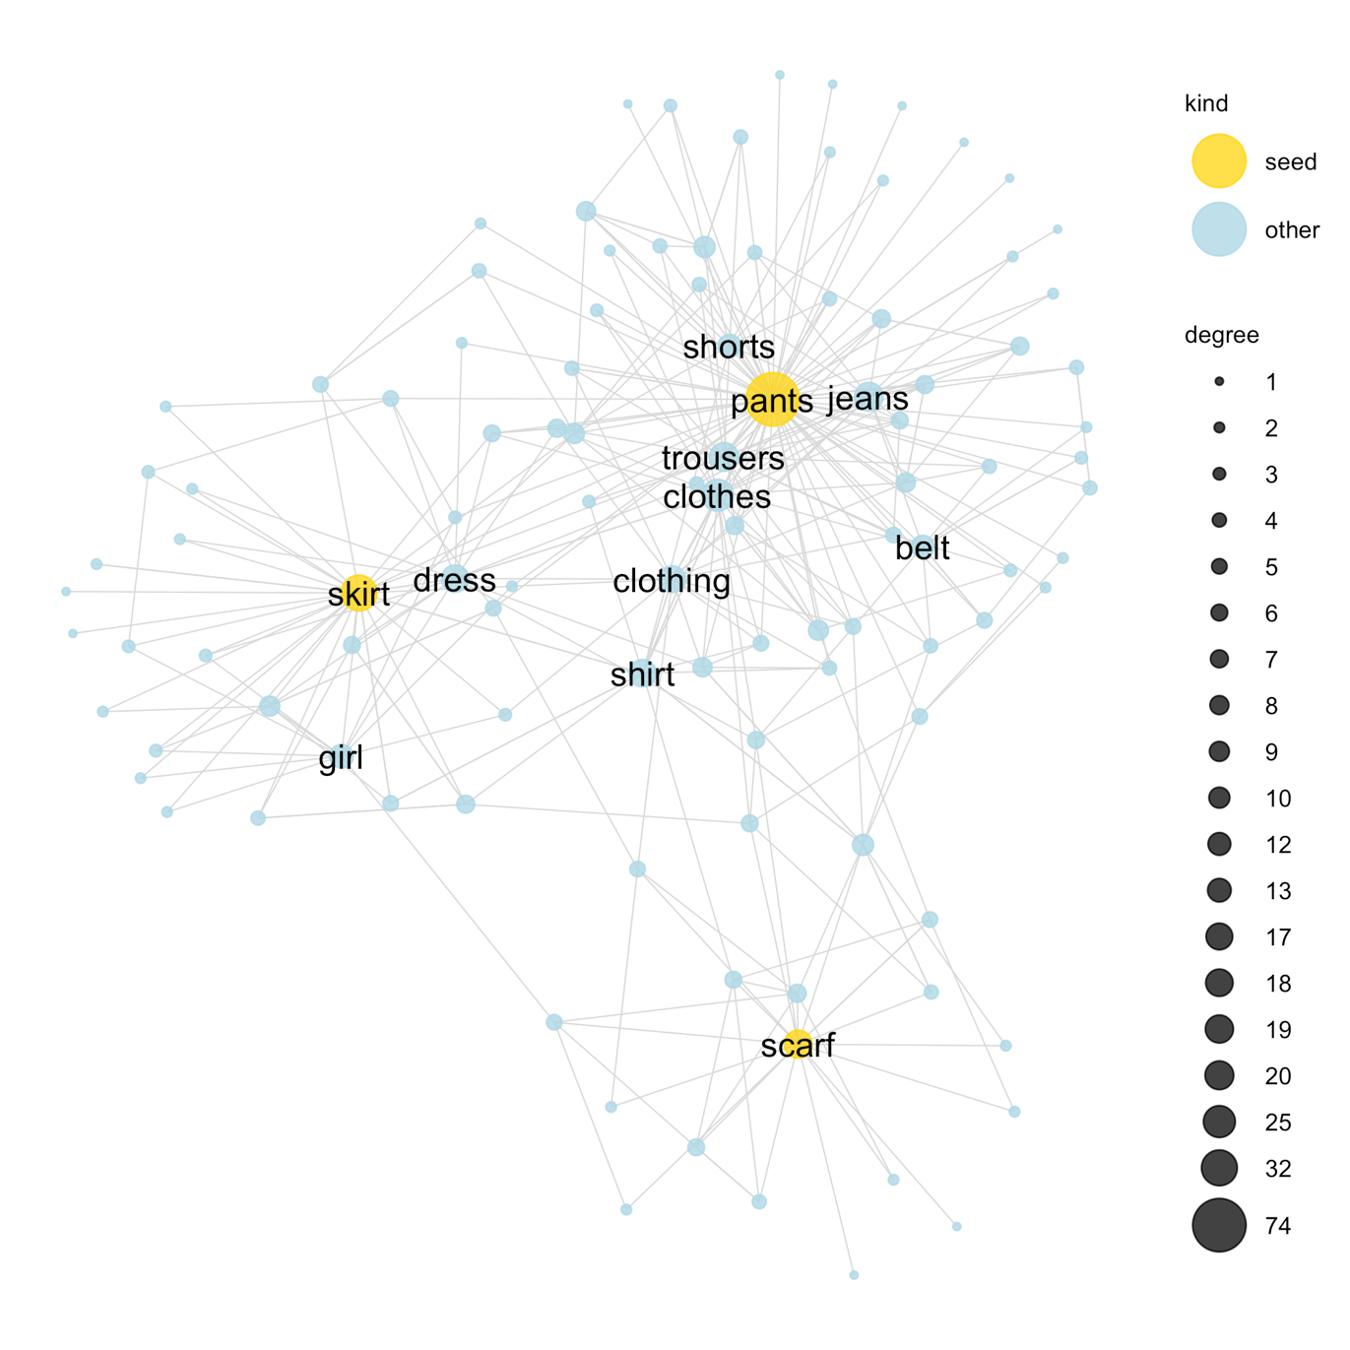
Local structure
Example 2
Cue: (pants, skirt, scarf)
Again we see the relevant superordinate category, clothing, arise as the concept that links them together
The network encodes typicality: pants and skirts are “better” examples of clothing than scarves
The network picks out other clothes

Slide 13
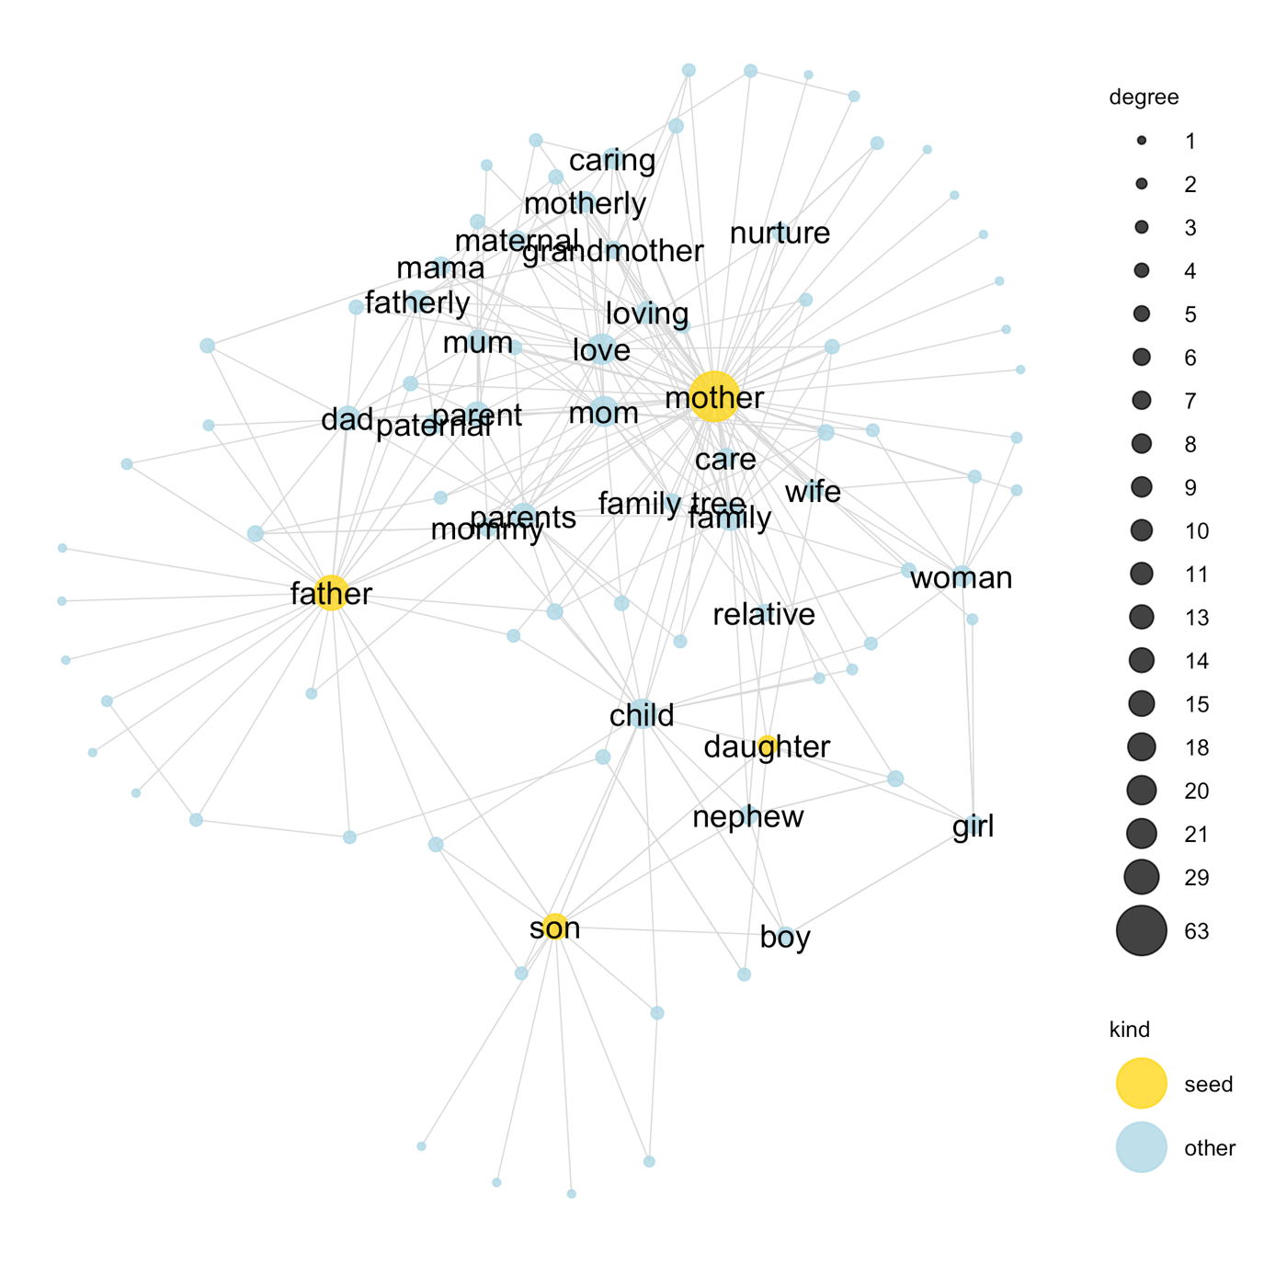
Local structure
Example 3
Cue: (mother, father, son, daughter)
The structure of the kinship terms emerges
Parents (top) and children (bottom)
Male (left) and female (right)
Encodes assumptions about family structure:
Mother is more central
Mother is more loving
Etc.

Slide 14
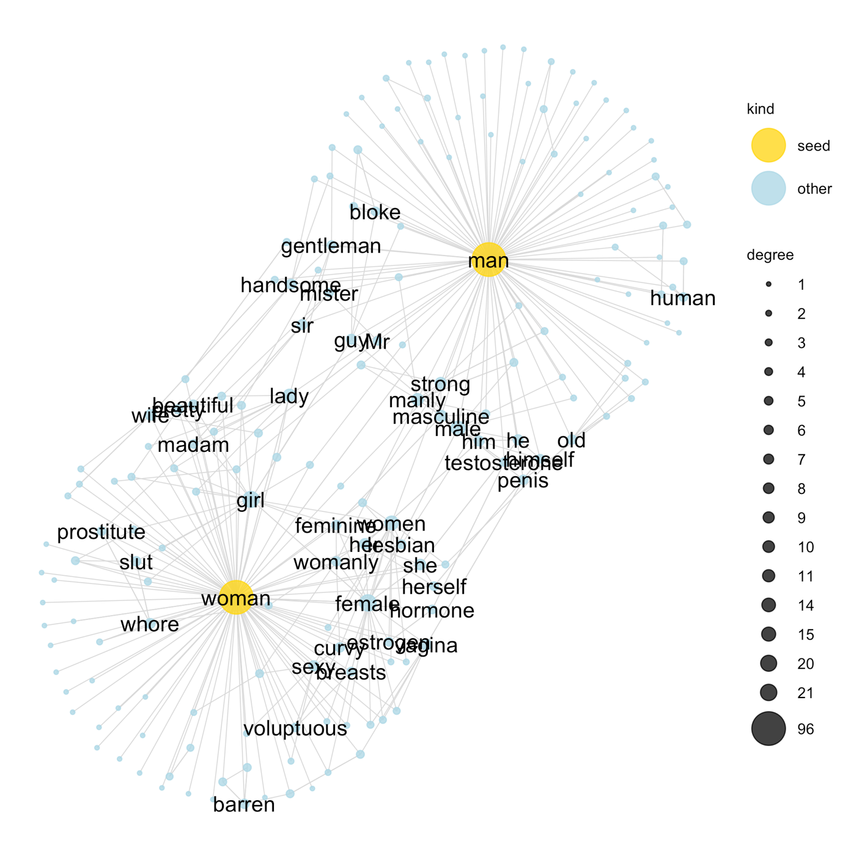
Local structure
Example 4
Cue: (man, woman)
The network encodes a lot of implicit knowledge and prejudices about our categories
The semantic network encodes the gender biases in the language ☹

Slide 15
Non-obvious structure?
(Measuring remote associations)

Slide 16
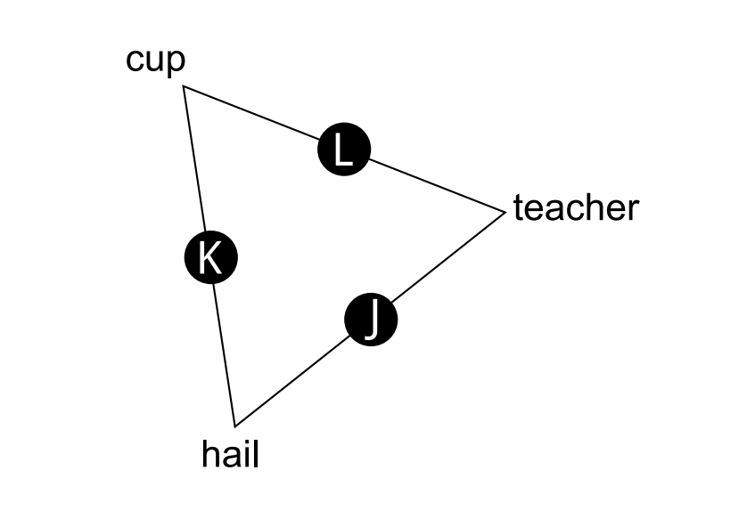

Slide 17
Remote associations
(De Deyne et al 2016)
Triad task: present people with three very dissimilar words, select the pair that is most similar
e.g., click “L” for cup and teacher
Task designed to match stimuli on various other measures (e.g., word frequency, abstractness)
If semantic networks are genuinely capturing something other than just “strong relationships”, we should be able to predict people’s choices

Slide 18
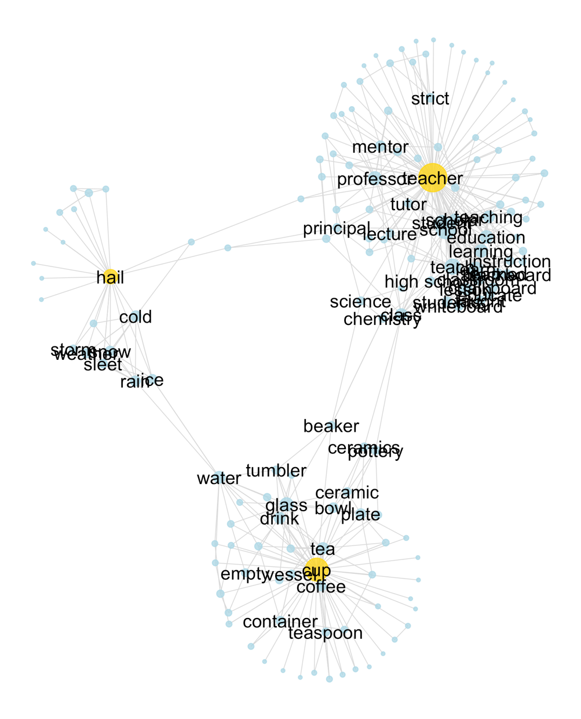
Remote associations
(De Deyne et al 2016)
There are no direct connections here
There are more “short paths” connecting cup and teacher than either of the other two possibilities
The network predicts that there should be a modest bias to prefer cup-teacher as the most similar pair

Slide 19
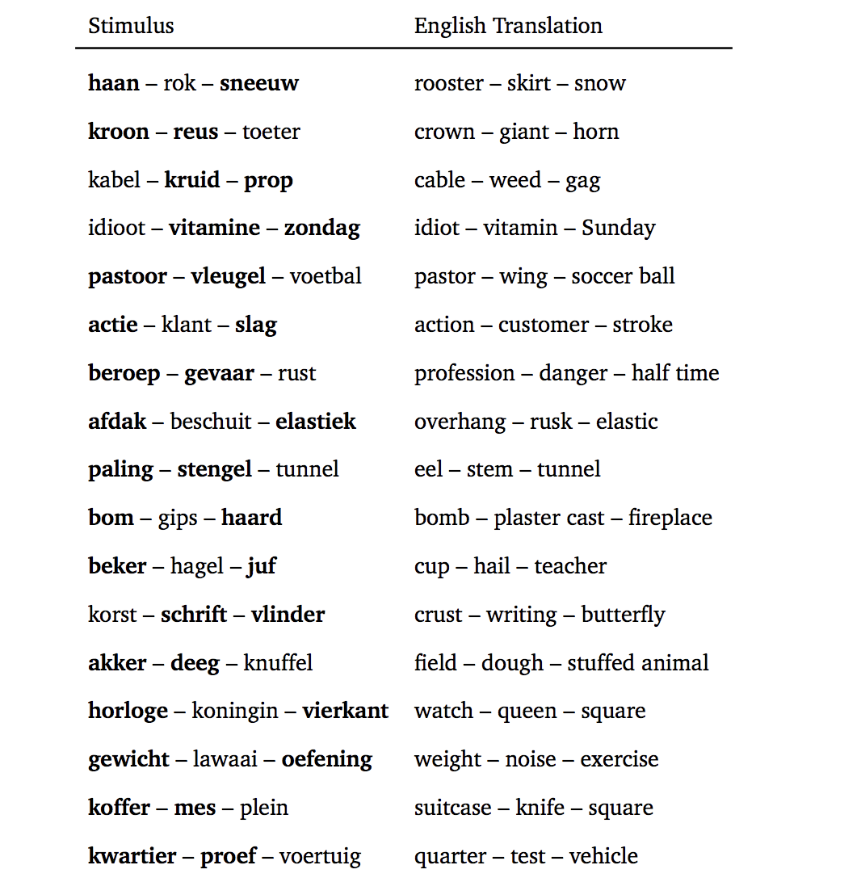
Remote associations
(De Deyne et al 2016)
The predicted pair is the more commonly chosen

Slide 20
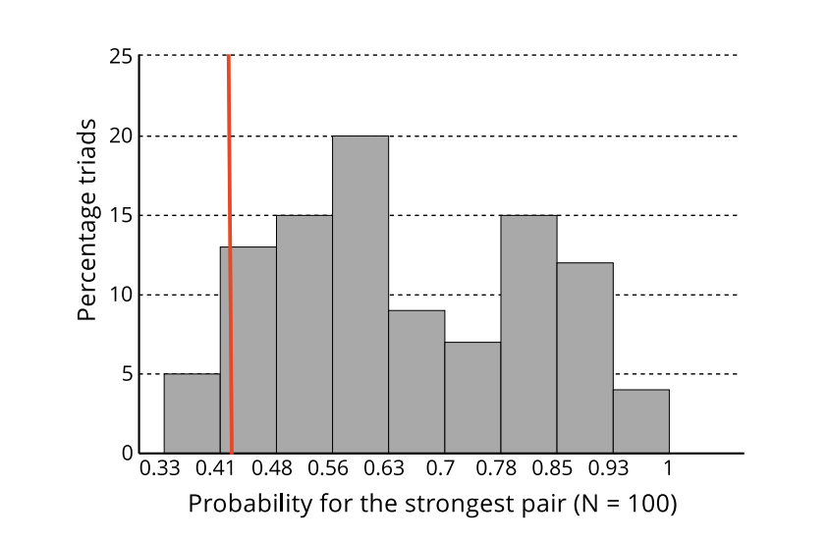
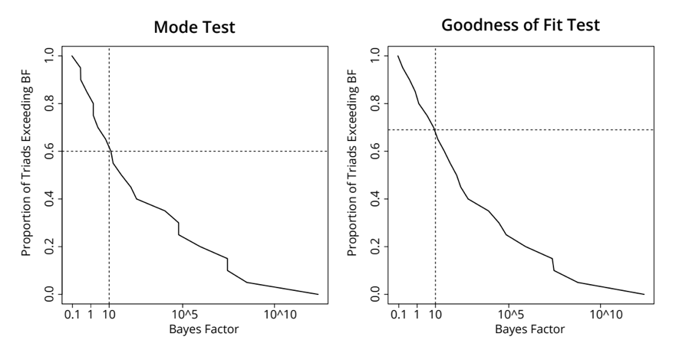
Remote associations
(De Deyne et al 2016)
Histogram of the proportion of people making the most-common choice, across triads
There is a (surprising?) amount of agreement across people
(Hypothesis testing for this isn’t trivial… details of the analysis not important for this class)

Slide 21
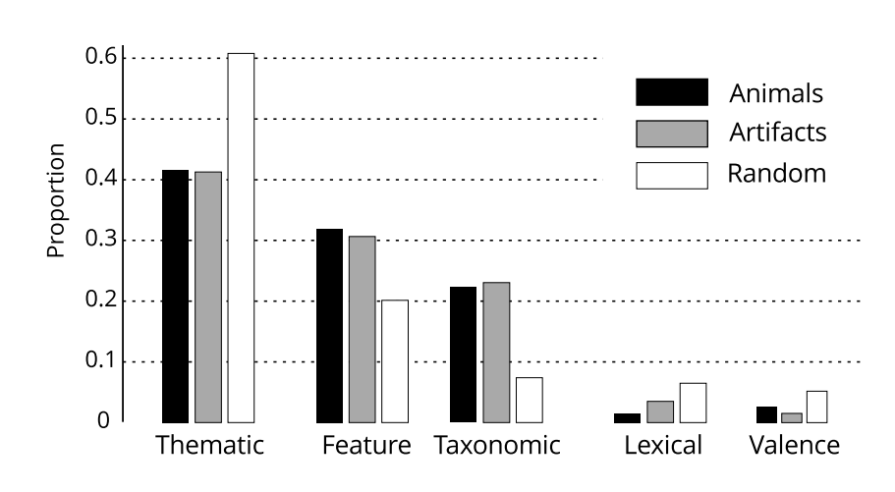
Remote associations
(De Deyne et al 2016)
Maybe there’s an unmeasured confound?
Just ask people why they made their choices and see
Doesn’t seem to be anything systematic
People give lots of different explanations/rationalisations for their choices!

Slide 22
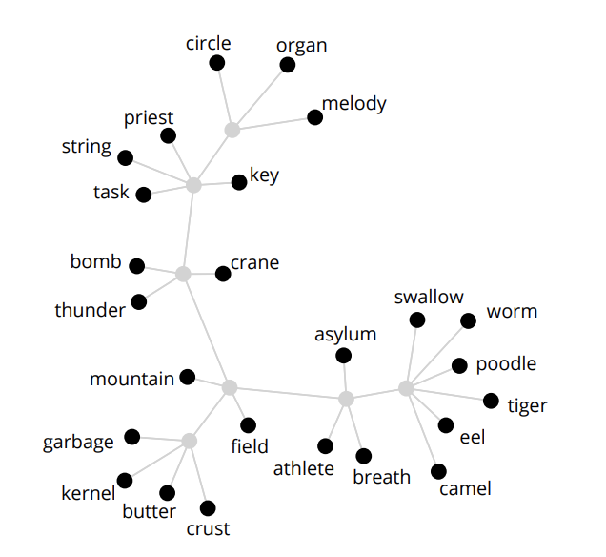
Remote associations
(De Deyne et al 2016)
Why does a semantic network account work so well? I don’t know
A suspicion:
Networks can represent arbitrary structure easily
Other methods we tried using (e.g., hierarchical, taxonomic structures) weren’t very flexible and gave nonsense answers
Might be as simple as… we have lots of data and a flexible tool for summarising it ☺
This “taxonomic” structure is pretty meaningless and misses lots of important details!

Slide 23
Large scale structure

Slide 24
How are semantic networks organized?
(Steyvers & Tenenbaum 2005)
Hierarchical network?
Unstructured network?
“Small world” graph
animal
mammal
bird
emu
magpie

Slide 25
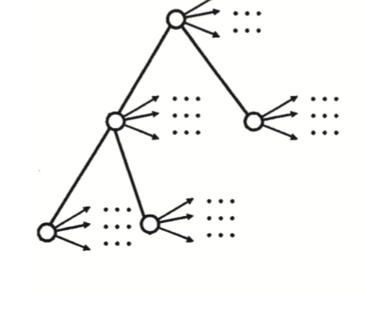
How are semantic networks organized?
This is unlikely
Hierarchical network?
There’s no evidence for it in word association networks
If networks are hierarchical we should be slower to verify “high level” features…
animal
mammal
flies
bird
“Magpie” is closer to “swoops” than “wings”
We should be faster to verify “magpies swoop” than “magpies have wings”
Not generally true
bird
wings
feathers
emu
swoops
magpie
magpie
Australian

Slide 26
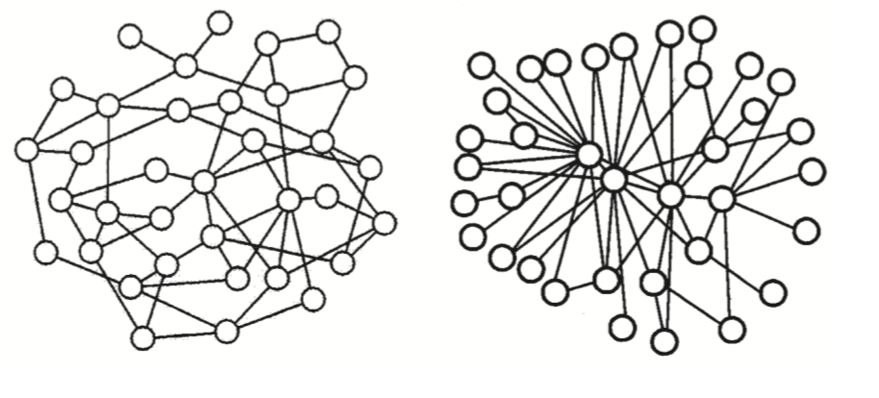
How are semantic networks organized?
(Steyvers & Tenenbaum 2005)
Unstructured network?
“Small world” graph
What’s the difference?
Small world graphs have “surprisingly” short paths between nodes
Small world graphs have a lot of “clustering”

Slide 27
How are semantic networks organized?
(Steyvers & Tenenbaum 2005)
The degree of a node k is the number of connections it has
k=2
k=2
k=1
k=5
k=1
k=1
Key property of small-world graphs: a small number of “hub” nodes with very high connectivity

Slide 28
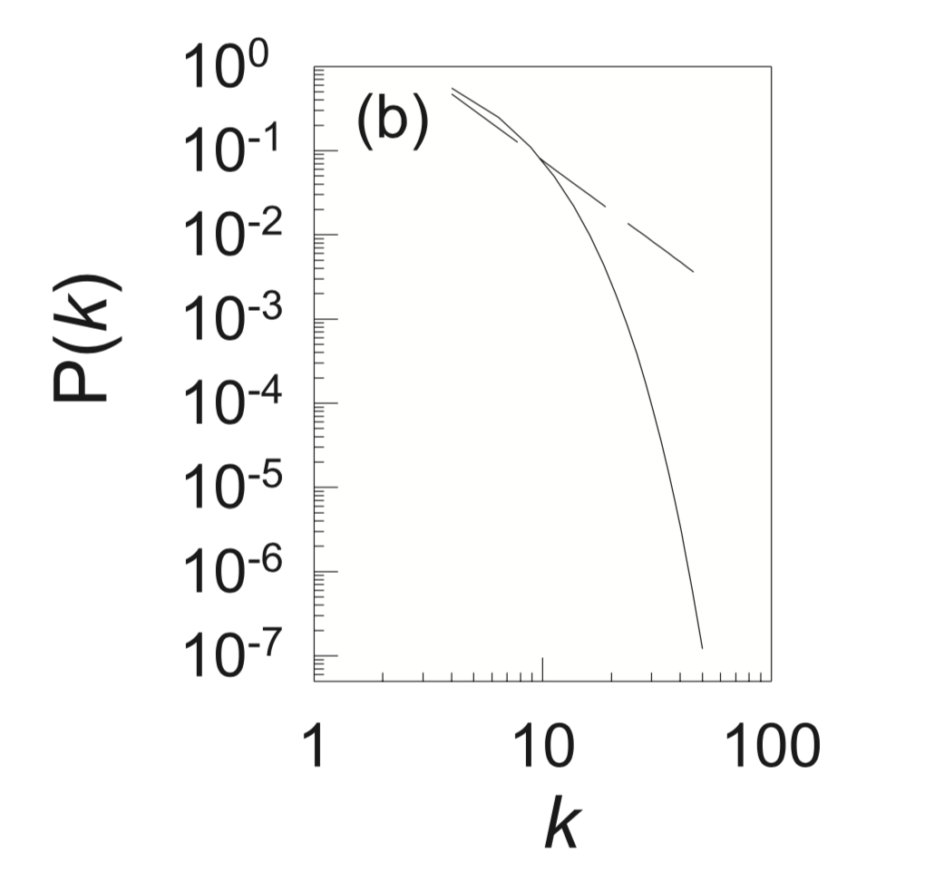
How are semantic networks organized?
(Steyvers & Tenenbaum 2005)
The diagnostic signature we’re looking for is a power law for the degree distribution
The proportion of nodes in the network with degree = k
A “power law” is linear when plotted on a log-log scale
The degree, k
(* technical details hidden here)

Slide 29
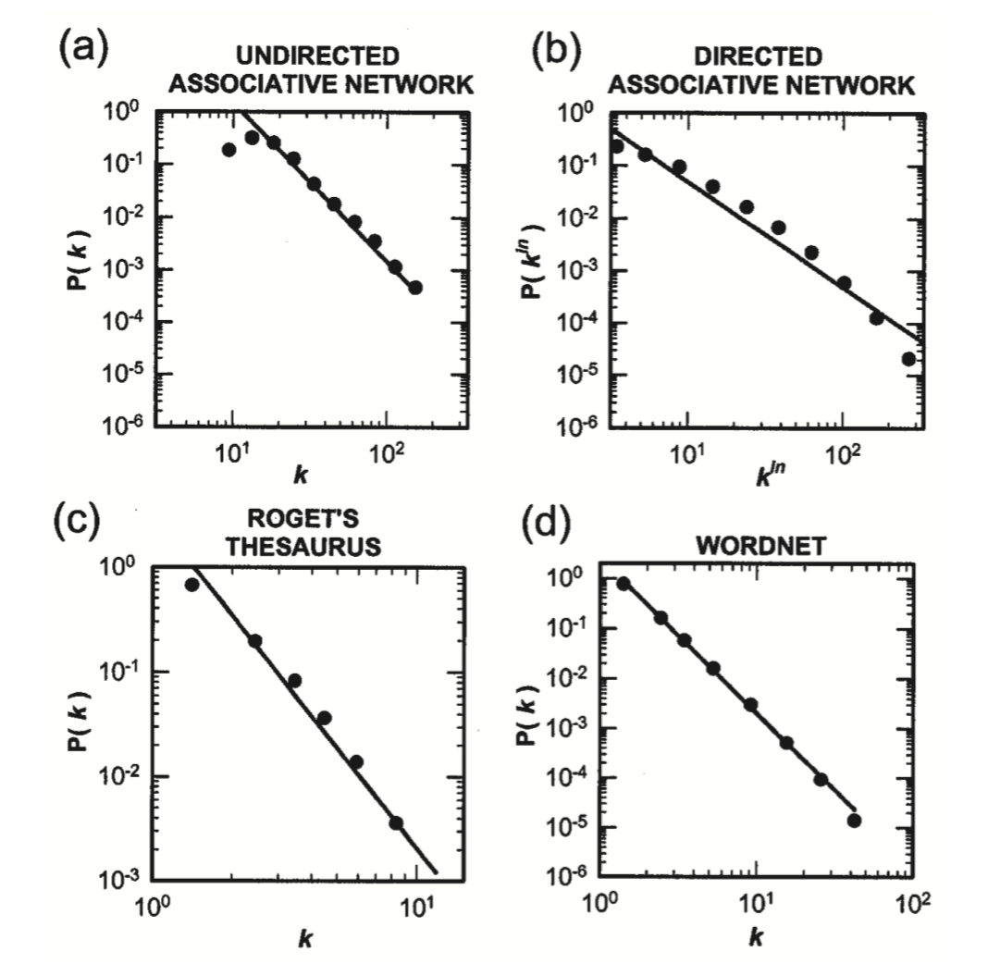
How are semantic networks organized?
(Steyvers & Tenenbaum 2005)
Four different ways of measuring the structure of semantic networks, all of which show the same pattern

Slide 30
Semantic networks for individuals

Slide 31
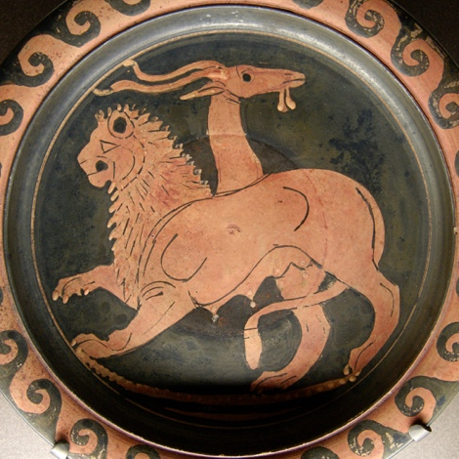
A source of concern
Most sources of semantic network data aggregate responses from many people
There are many situations where the data from aggregate systematically misrepresent the data from individuals
Aggregated
Individual
person 1
person 2
person 3

Slide 32
Semantic networks of individuals
(Morais et al 2013)
How to measure one person’s semantic network? …snowball sampling
Generation 1
Generation 2
Generation 3

Slide 33
Semantic networks of individuals
(Morais et al 2013)
Start with seed words (yellow)
Get all associations to those words (orange)
Start with the 2nd generation words (orange)
Get all associations to those words (purple)
Etc.
Complete as many iterations as possible within a 7 week testing period
Done with 6 individuals
Total time 30-60 hours per person!

Slide 34
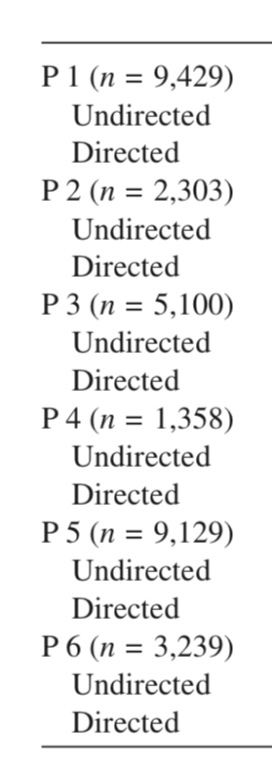
Semantic networks of individuals
(Morais et al 2013)
A lot of variability in the number of words generated: ranges from 1358 to 9429

Slide 35
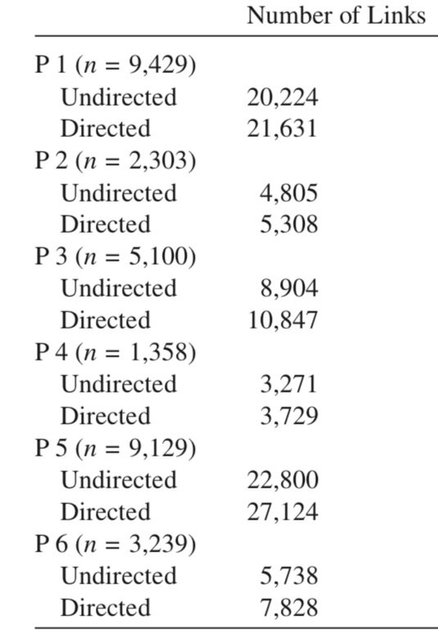
Semantic networks of individuals
(Morais et al 2013)
This is reflected in a similar level of variability in the number of links

Slide 36
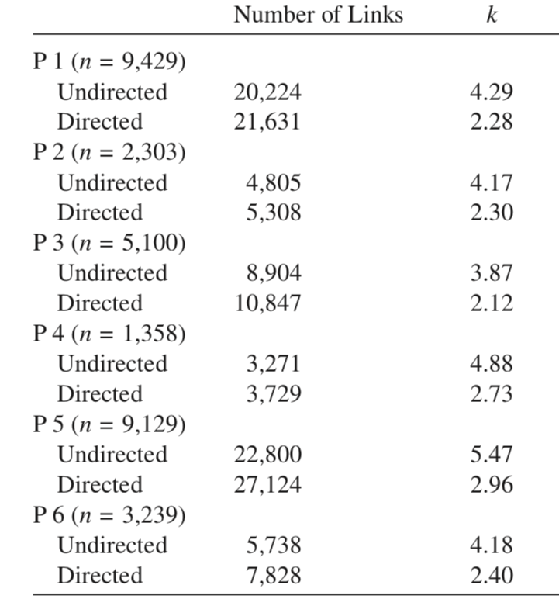
Semantic networks of individuals
(Morais et al 2013)
The average connectivity (degree, k) of nodes is more stable across individuals
Overall, individual networks appear to be sparser (lower connectivity, fewer links) than the aggregate ones

Slide 37
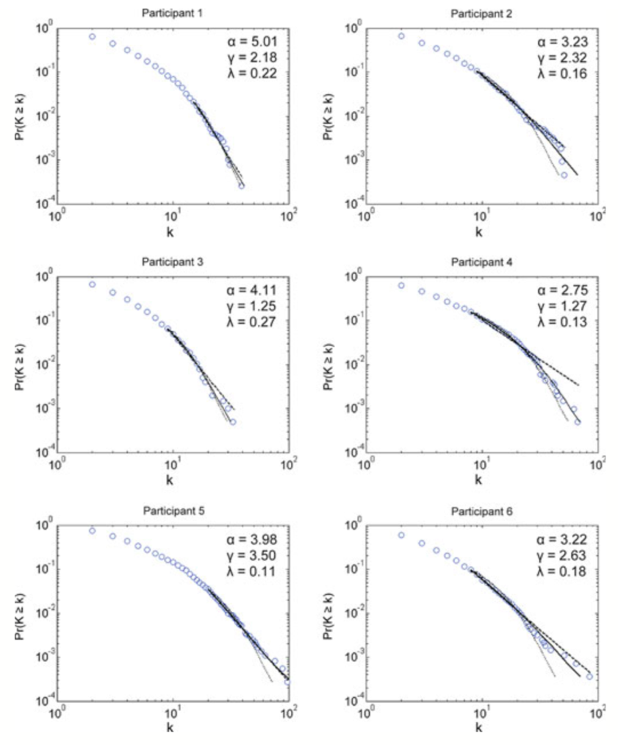
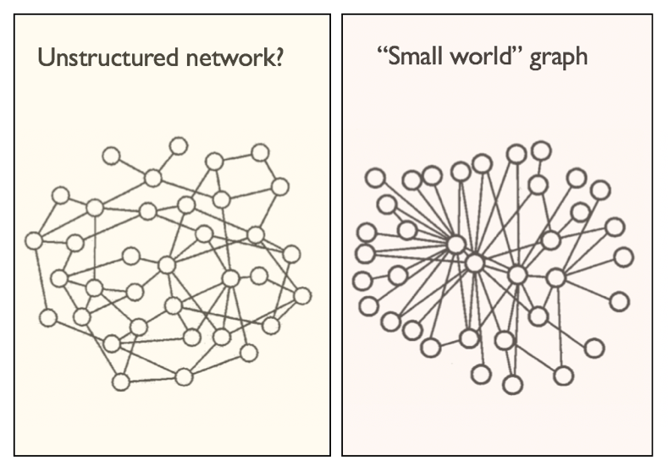
Semantic networks of individuals
(Morais et al 2013)
The individual subject networks do show small world structure, but it’s not quite as clear cut as for the aggregate networks
(details of this graph not important for this class)

Slide 38
Developmental trajectory

Slide 39
Developmental changes
(Dubossarsky et al 2017)
Large-scale cross sectional study: 8000 people, aged 10-84
Subset of the Dutch language version of the small world of words study
The younger age groups supplemented by recruiting from schools in Flanders
Age Group | Average Age | #Participants | Total responses | Unique responses
9-10 | 9.2 | 490 | 36444 | 6441
11-12 | 10.5 | 466 | 40319 | 6904
13-14 | 13.5 | 502 | 42625 | 7970
17-19 | 18.3 | 1081 | 48630 | 8663
28-32 | 31.0 | 1136 | 49613 | 8947
38-42 | 41.0 | 1152 | 49626 | 9501
48-52 | 51.0 | 1223 | 49688 | 10280
58-62 | 61.0 | 1279 | 49806 | 11144
+68 | 71.9 | 1222 | 49508 | 12538

Slide 40
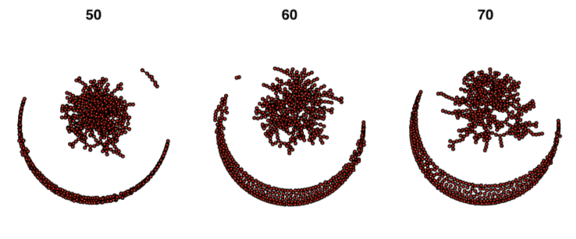
Developmental changes
(Dubossarsky et al 2017)
Network becomes larger, denser, better connected into mid life, with a slight reversal in later life.
It’s not a “simple” inversion though

Slide 41
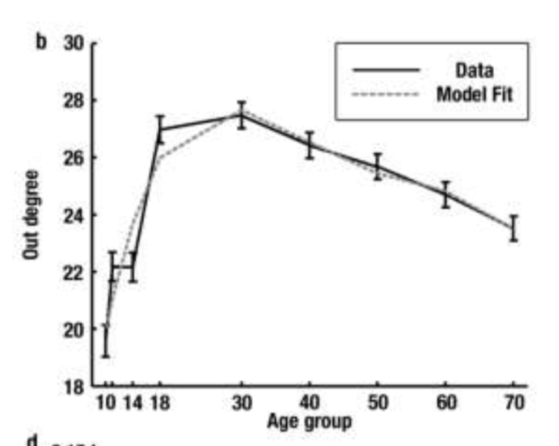
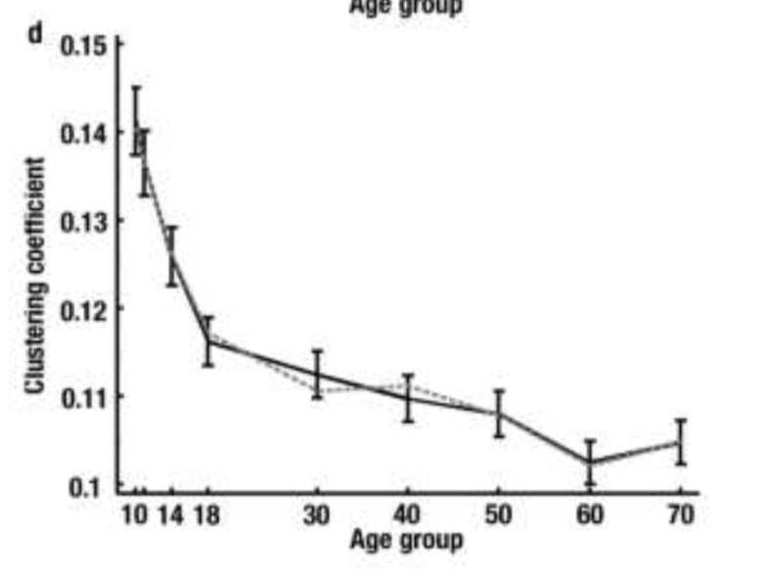
Developmental changes
(Dubossarsky et al 2017)
The average degree (number of connections) of individual node shows the inverted U shape…
But the overall “clustering” in the graph shows a monotonic trend across the lifespan…

Slide 42
Thanks!

